Slide 1

MBDCPS
Project 2
Group 24

Slide 2
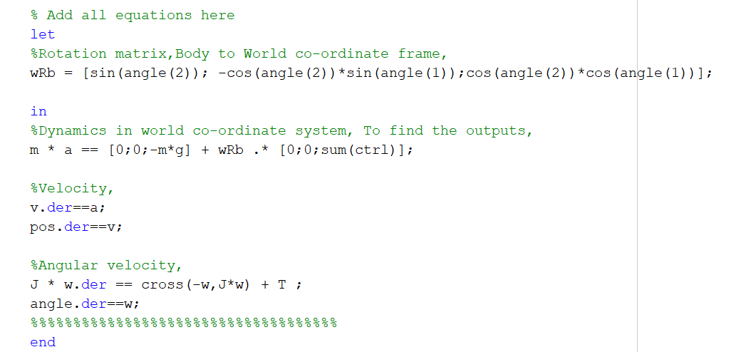

Task 2
Units
Drag Coefficient $→$ N/(rad/s)^2
Lift Coefficient $→$ N*m/(rad/s)^2

Slide 3
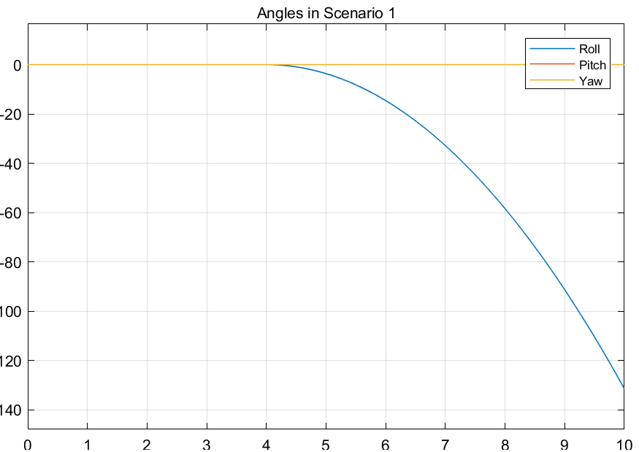
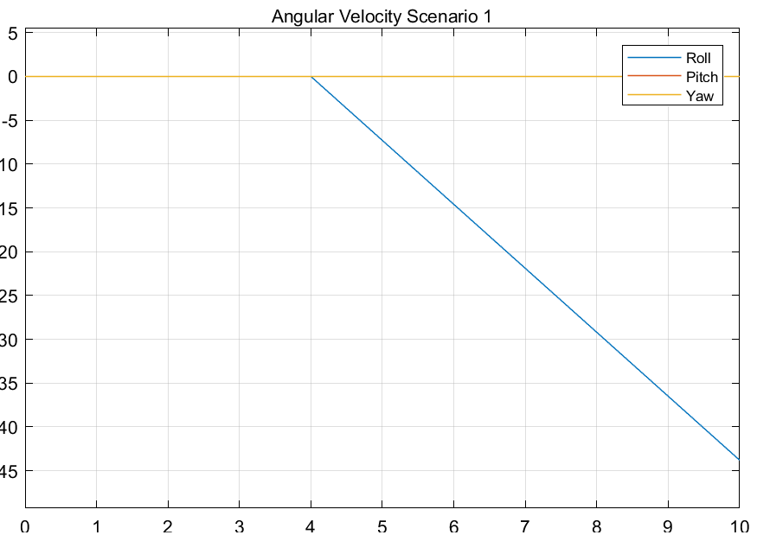
Task 3
Scenario 1

Slide 4
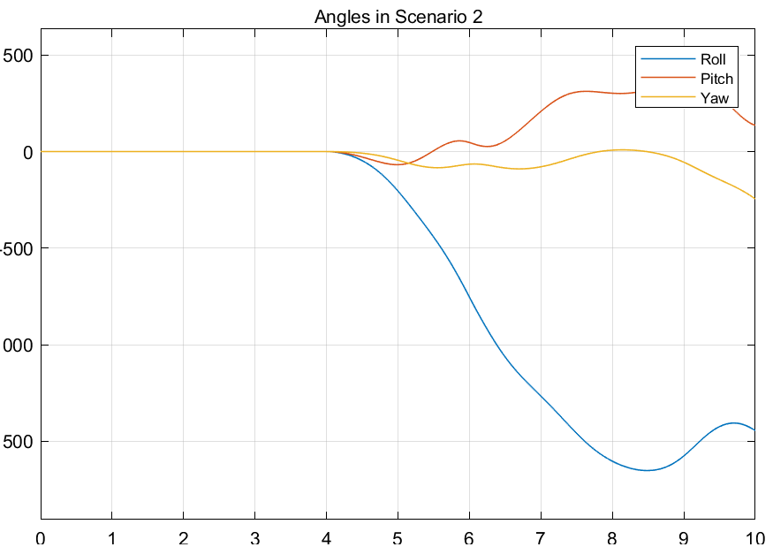
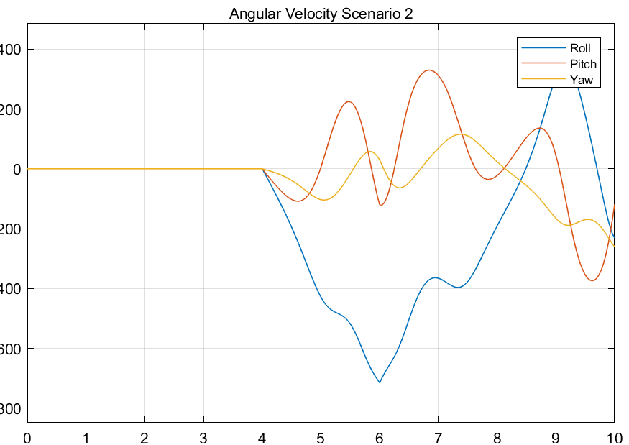
Task 3
Scenario 2

Slide 5
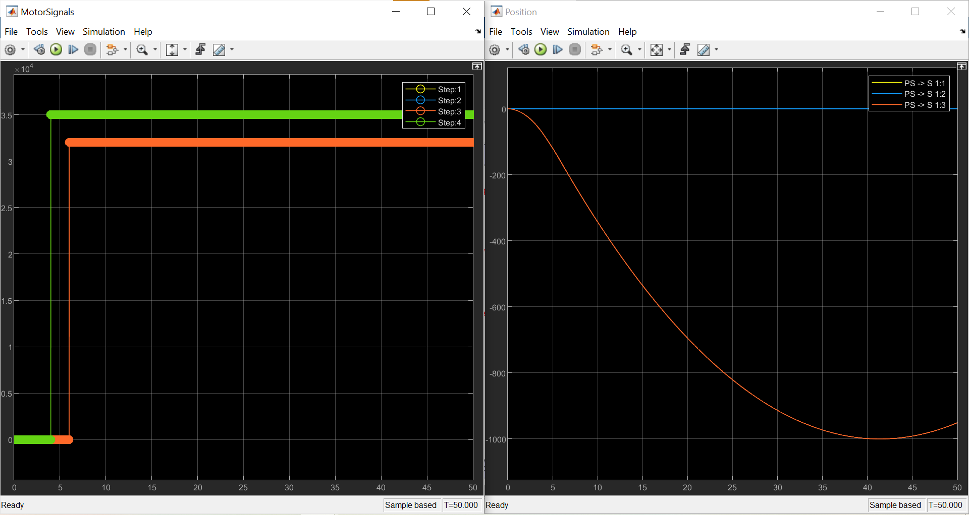

Task 3
Created Scenario
Motor 1 : Final Value $→$ 32000
Step time $→$ 6
Motor 2 : Final Value $→$ 35000
Step time $→$ 4
Motor 3 : Final Value $→$ 32000
Step time $→$ 6
Motor 4 : Final Value $→$ 35000
Step time $→$ 4

Slide 6
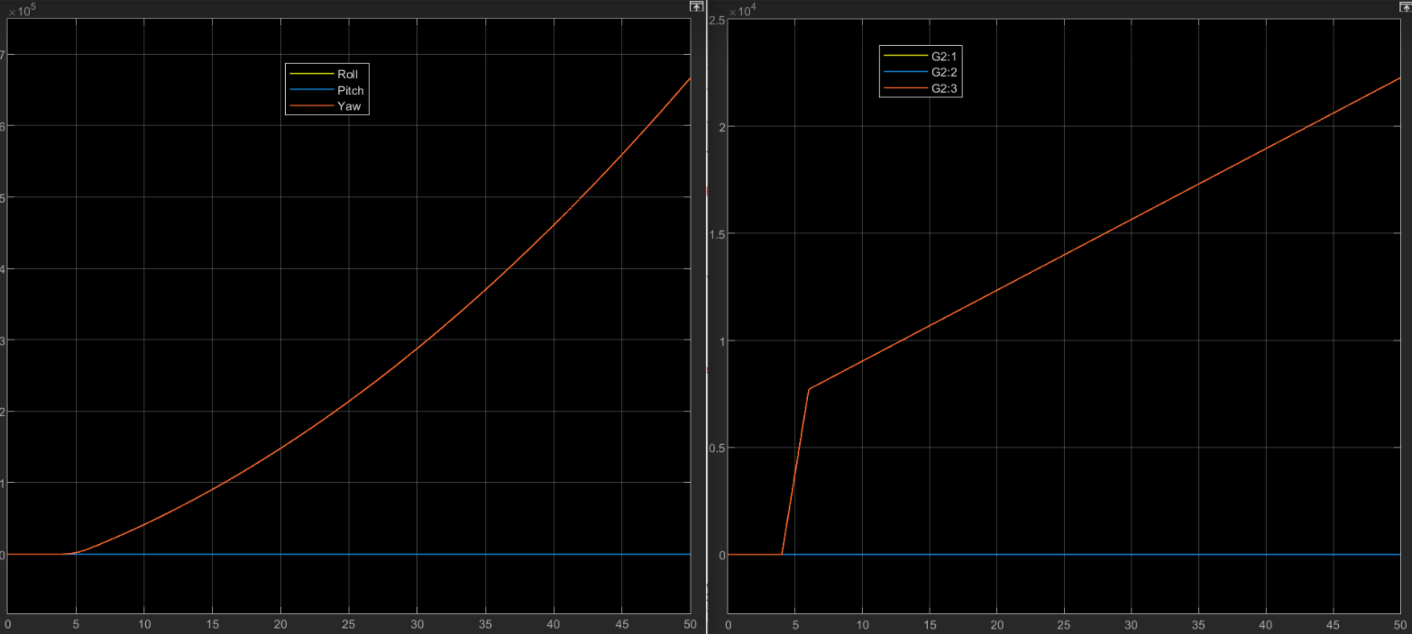
Task 3
Created Scenario

Slide 7
Task 4
J* dw/dt = -w x Jw + T => f = 0 = -w x Jw + T
Where T is the torque vector in 3 dimensions, composed from the applied rotor torque.
The linearization gives the matrices: A = df/dx, B=df/du. Where u = T, and x = [roll,pitch,wx,wy,wz]

